Slide 1
DriverPass System Analysis
Sean Toon
6/24/23
Notes:
[No speaker notes required for this slide.]

Slide 2

System Requirements
Non-Functional:
The system should perform at efficient speeds. There should be minimal lagging and bugs for any environment. User interface interactions should be responsive and reliable.
The system should be analyzed and updated on a regular basis and should be updated by request or use case scenarios.
Functional:
Administrator Requirements:
The system shall allow for students to be tracked.
The system shall allow user information changes.
The system shall support management of access, functionality, views, and security roles depending on user rights.
The system shall allow to be viewed before publishing.
The system shall support custom fields.
User Registration and login
The system shall validate user credentials when logging in.
The system shall allow students to self- register into classes through the course catalog.
Notes:
I felt that the non-functional requirements that I listed in the PowerPoint were a good choice because they are top priority requirements. It is important that the system runs at efficient speeds and lacks as many bugs as possible so that the client is satisfied with the product and users want to keep using the product. The second non-functional requirement kind of plays into the first because it is the requirement needed to ensure that the first requirement is true. It is important that the system will continually be updated and maintained over the course of its life.
The functional requirements that I listed relate to the Administrator functional requirements. I chose the Administrator functional requirements because a system without an Administrator would simply fall apart. The administrators of DriverPass need to have clear and effective requirements so that the whole system function smoothly and so that the customer and users have support.

Slide 3
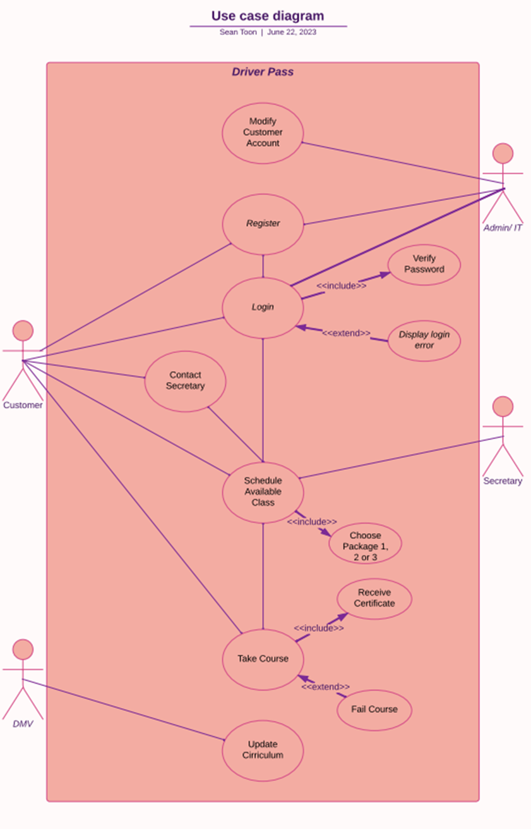
Use Case Diagram
Actors:
Admin/IT, Customer, Secretary, DMV
Use Cases:
Modify Customer Account, Register, Login, Contact Secretary, Schedule Available Class, Take Course , Update Curriculum.
Explanation:
In the DriverPass interview conducted by the Product Owner, the employees listed for the system were administrators, IT specialists, a secretary and an owner. Employees of DriverPass will handle most of the backend tasks of the website/business. DriverPass employees coordinate with customers to ensure that they are getting the extra driving skills needed with excellent customer care and support.
Notes:
[Explain your diagram. Who are the different actors in the system? What are the different use cases? How did you account for DriverPass’s needs in your design? In your explanation, keep your audience in mind. Avoid the use of terms like “actors” and “use cases” in your explanation.]

Slide 4
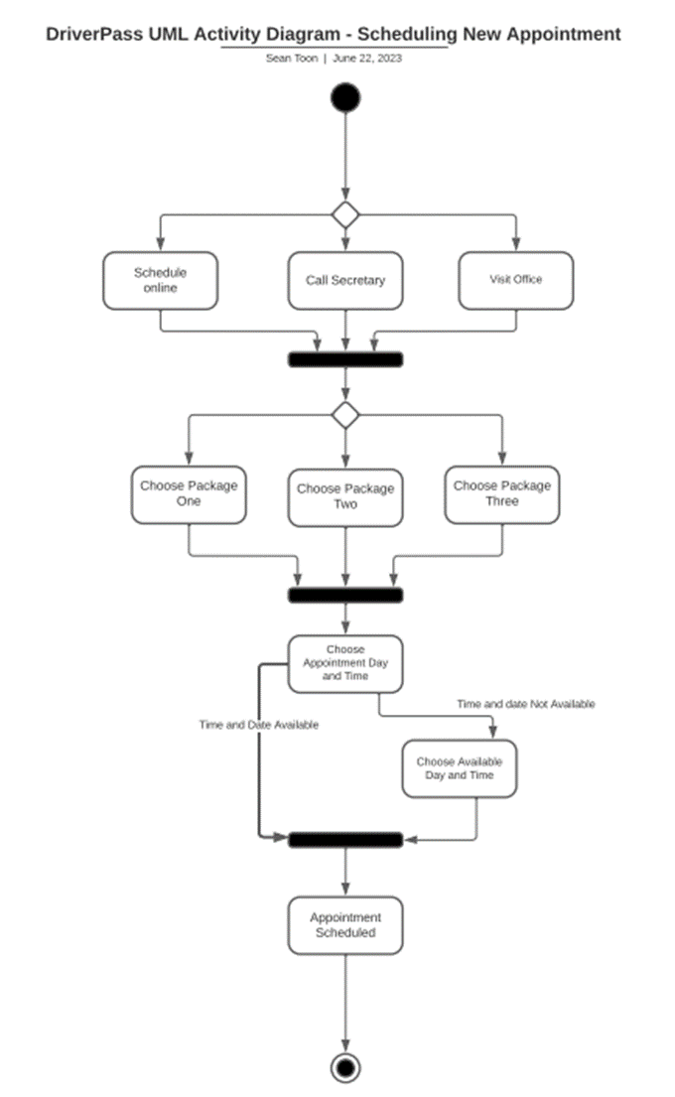
Activity Diagram
The activity diagram explains the process of scheduling an appointment with DriverPass. The customer can either schedule online, call the secretary or schedule in person. In either case the customer will have to pick a desired package and schedule a pick- up time that is available.
Notes:
[Explain your diagram. Which use case are you breaking down? What are the steps for this use case? How did you account for DriverPass’s needs in your design? In your explanation, keep your audience in mind. Avoid the use of technical terms such as “nodes,” “control flows,” and so on.]

Slide 5

Security
The system shall include data encryption, access controls, and protection against unauthorized access or data breaches.
If there is a “brute force” hacking attempt on an account, the account needs to be suspended and locked by admin, and account member will need to be notified.
If a user forgets their password, there will be options to reset the password through account email or account phone. If either option is not doable, admin or IT service will be available, and password can be changed with proof of identification.
Notes:
[How did you consider security in your design? In your explanation, keep your audience in mind by avoiding the use of technical terms.]

Slide 6
System Limitations
Limited integration capabilities
may have limited data exchange and interoperability with other educational or other external systems.
Technical constraints
may have a tight or seemingly unachievable time limit.
may have limited resources.
may have limited project development expertise and physical capability.
may have insufficient funding.
Notes:
[What are the limitations of your design? In your explanation, keep your audience in mind by avoiding the use of technical terms.]

